Slide 1
Welcome to Hello World Series
What is a GIT Client

Slide 2
Problem statement
I am a developer and already have my/others’ repo on GitHub/BitBucket/GitLab/Assembla servers.
Now I want to connect to any of the Git repo from my local machine.

Slide 3
In last tutorial...
We discussed – How to install Tortoise GIT client

Slide 4




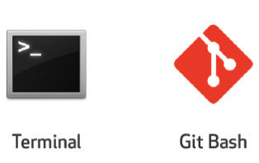
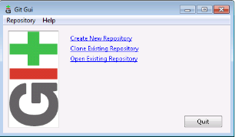



In this tutorial...
We will see, Which software do I need to connect to any of the GIT repo hosted on any of the servers like either GitHub, BitBucket Assembla, GitLab .
GIT Servers
GIT Clients

Slide 5
What is GIT Client
Git Client is a software used to connect to Git Server.
Git server could be Github.com or Bitbucket or Assembla or GitLab or any other Git repository in your internal network.
Git client can also be of multiple types like command based client, GUI based client and Eclipse Plugin based client. Let’s see each type of clients one by one.

Slide 6
GIT Client – Command based

Slide 7
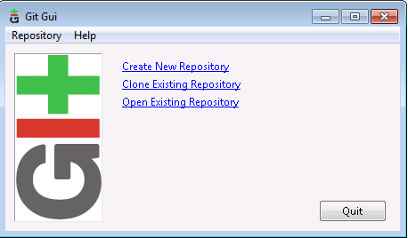
GIT Client – GUI based

Slide 8
GIT Client – GUI based

Slide 9

GIT Client – GUI based

Slide 10

GIT Client – GUI based

Slide 11
What’s next…
In coming up tutorials, we will see each type of Git clients in details aling with their installation, connecting to Git repository and performing necessary operations like checkin, checkout, delete, check history etc.

Slide 12
Coming up Next
Git Bash Client and GIT GUI client installation
Notes:
In Slide Show mode, click the arrow to enter the PowerPoint Getting Started Center.

